Slide 1

Forecasting Central Bank Liquidity
31 maY 2022
Center of excellence in Finance
Romain Lafarguette, Ph.D. (MCM/CO)
https://romainlafarguette.github.io/

Slide 2
Overview
Forecasting infrastructure based on high-quality open-source codes
Forecast the three main autonomous factors separately and the net liquidity position
Using the most recent methods in the statistical literature
Easy to use for central banks: complex modeling issues are taken care of automatically
Provides automatic reporting and data visualization for daily operations
Team of experts (MCM, ITD, STX) to help the authorities during missions

Slide 3
TA Guidance
New standard for IMF Technical Assistance missions on Central Bank Liquidity Forecasting
Gain time to deploy top-notch infrastructure during TA missions, incl. documentation
“8-eyes” principles: 4 experts have thoroughly designed and tested thousands lines of codes
Leveraging on the experience gained over 8 TA missions (AE/EM/LIC) and more to come
Modular: the authorities can choose which item to forecast; we customize the infrastructure
We are here to help
Contact rlafarguette@imf.org or MCMCO-MGT@imf.org

Slide 4
The Team
Project Leader: Romain Lafarguette, Ph.D. (MCM, Eng/Fra/Chn)
ITD experts
Kei Moriya, Ph.D. (ITD, Eng)
Adeleke Adeyemi, Ph.D. (ITD, Eng)
External Experts
Prof. Anastasios Panagiotelis, Ph.D. (Univ. Sydney, Eng)
Prof. Nikolaos Kourentzes, Ph.D (Univ. Skovde, Eng)
Alain Quartier-La-Tente, Ph.D. (INSEE France, Eng/Fra/Esp)
Etienne Vaccaro-Grange, Ph.D. (NYU Abu Dhabi, Eng/Fra)
… and more to come !
We also deliver general training in forecasting and programming during MCM TA

Slide 5
Refresher: Analytical Central Bank Balance Sheet
Assets
Liabilities
Net Foreign Assets
Domestic assets
Other assets net
Currrency in circulation
Securities issued by the central bank
Liabilities to deposit money banks (banks’ reserves)
Capital and revaluation account
(Claims – liabilities to non residents)
Claims on the government
Claims on deposit money banks
Other assets – other liabilities
Government deposits
In red: Autonomous Factors
In green: Policy Position
In blue: Other Items

Slide 6
Autonomous Factors and Policy Position
Autonomous
Factors
= Net Foreign Assets
Policy position
+/- Open market operations
+ Government position*
- Currency in circulation
+ Standing lending facilities & ELA
- Standing deposit facilities
Supply of banks’ reserves
*Government position: claims on the government – government deposits

Slide 7
Liquidity Forecasting and Management
Calibration of the regular, short-term OMO (Open Market Operations)
The central bank targets an optimal level of commercial banks reserves / reserves growth
OMO are used to reach this optimal level/growth rate, based on the autonomous factors forecasts
Fine-tuning operations
Liquidity swings and deteriorations of money markets conditions can occur between two OMOs
Fine-tuning operations to smooth unexpected, unforecasted liquidity developments
Calibration of the required reserves
Required reserves with averaging create a liquidity buffer banks can use to smooth their liquidity during the reserves maintenance period
The central bank can calibrate the required reserves to absorb the expected forecasting errors, derived from the confidence interval estimation
Can have a systemic approach on the calibration of the different monetary policy instruments

Slide 8
Why Accurate Liquidity Forecasting is Important
Calibrate central bank operations accurately
Planify structural operations, calibrate the monetary policy instruments
Mitigate money markets volatility and strengthen financial stability
Improve monetary policy transmission
Support market development

Slide 9
Autonomous Factors Drivers
Autonomous Factors
Currency in circulation
Government Position
Net foreign assets
Other
Treasury cash-flow management (revenues and expenditures)
Transactional demand for banknotes/coins
Current and Capital Flows
Ad-hoc
Non-central bank borrowing from domestic and international markets
Dollarization/
De-dollarization

Slide 10
Models Relevant for Each Driver
Autonomous Factors
Currency in circulation
Government Position
Net foreign assets
Other
Treasury forecast bias-corrected
Time-series seasonality model
Time series volatility model
Expert judgment/ad-hoc model
Forecasts Aggregation via Hierarchical Methods

Slide 11








Models Family
Seasonality
Smoothing
Use regression based methods
Capture regular and irregular seasonality
With new parsimonious approaches
Memory effect
Adjust quickly to structural changes
Models
Volatility
Combination
Deal with complex data
Model volatility as a separate process
Combine multiple approaches
State space, regression & smoothing
Can handle more complex patterns

Slide 12
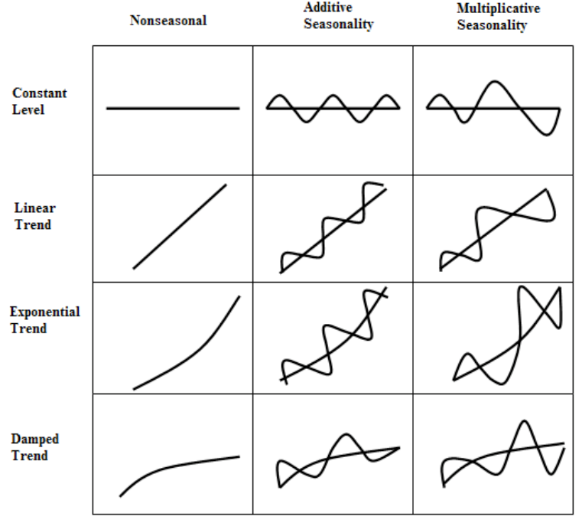
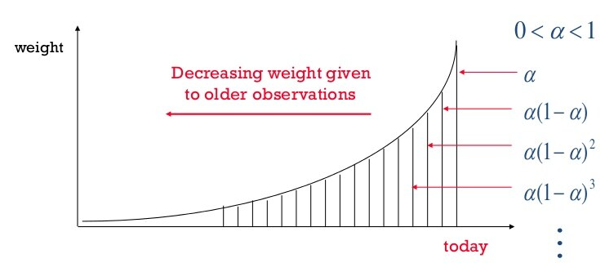
Exponential Smoothing

Slide 13
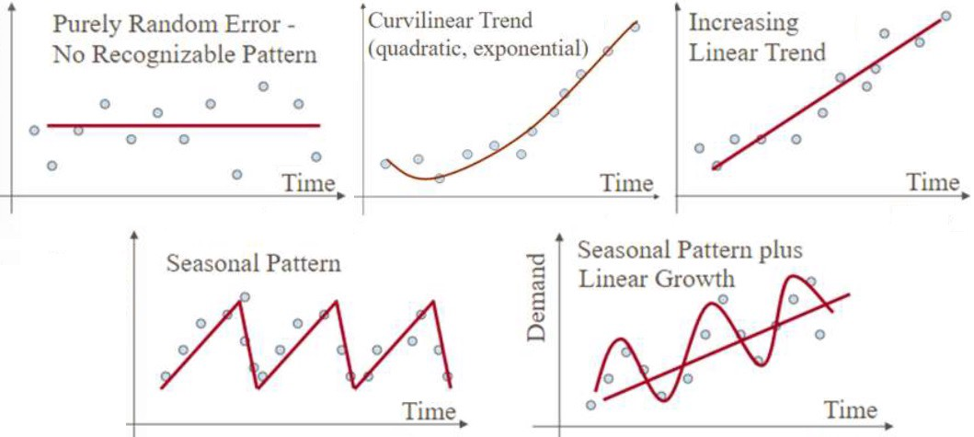
Time Series Patterns
Source: medium.com

Slide 14
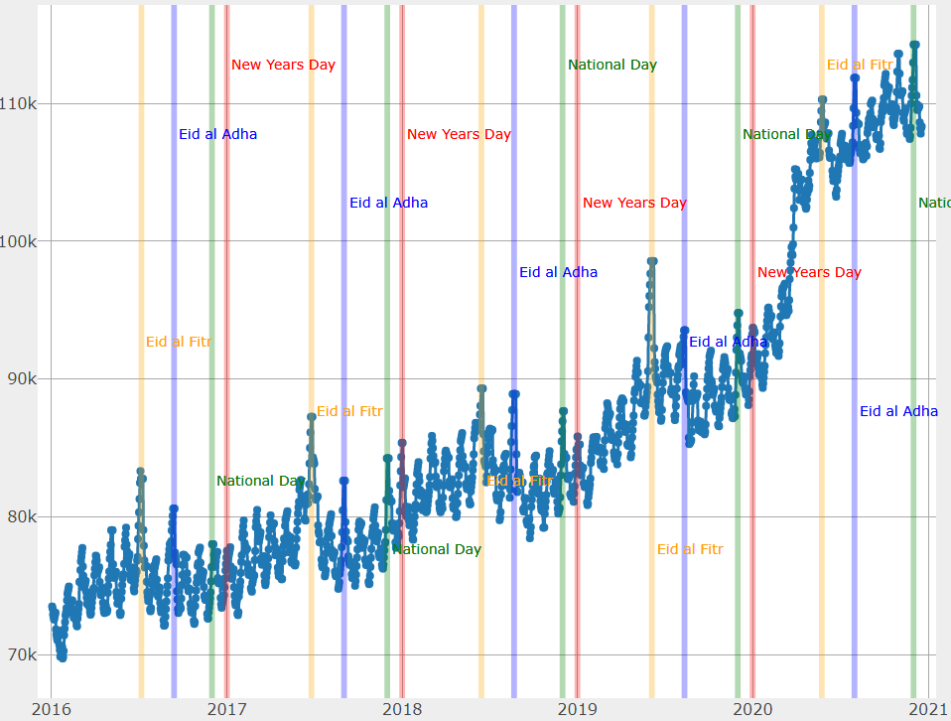
Seasonal Patterns in Practice

Slide 15
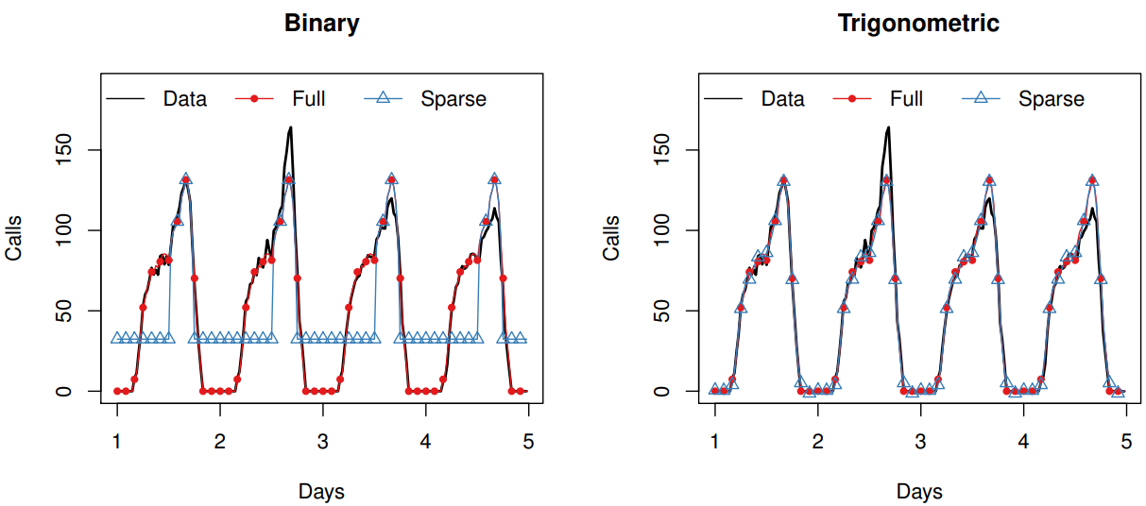
Modeling Seasonality
Binary tries to capture every single phenomenon
Trigonometric models a cycle : much more parsimonious

Slide 16




Statistical Trade-Offs
Data-driven decision
Features
Accurate models perform well in specific situations
Can underperform severely in other
Complexity
Capture a very particular, single, complex pattern
Accuracy
Performances
Robust models
perform reasonably well on average
Limited risk of underperformance
Forecastability
Capacity to handle different data patterns equally well
Rosbustness
Forecastability
Complexity

Slide 17



Models Selection
Leverage on Models Diversity to Reduce Modeling Risks
Single Models
Dynamic Selection
Model Averaging
Test each of them
Ranked by performance
Take the most recent best model
Adjust quickly to structural changes
Average the top 3 models
Reduce modeling risk

Slide 18
Empirical Strategy
Estimate all Models
Out-of-Sample Performance
How accurate each model is? What is the best model for each autonomous factor?
Forecast
Based on the best model, forecast
How each model exploits the information in the data?

Slide 19
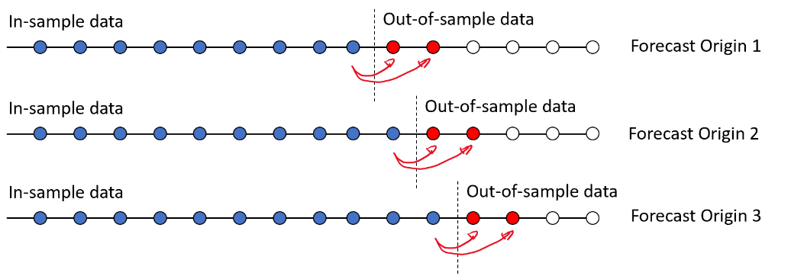
Out of Sample Performance: Concept
Source: alphascientist.com

Slide 20
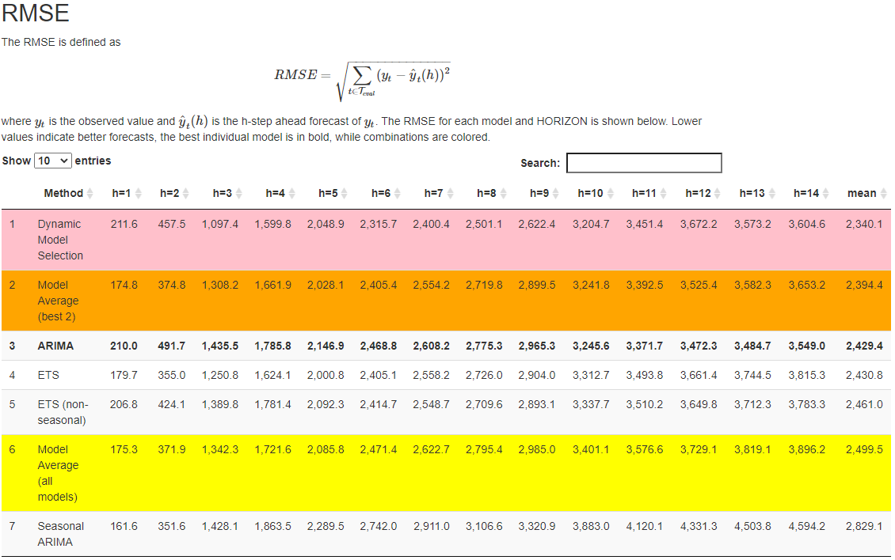
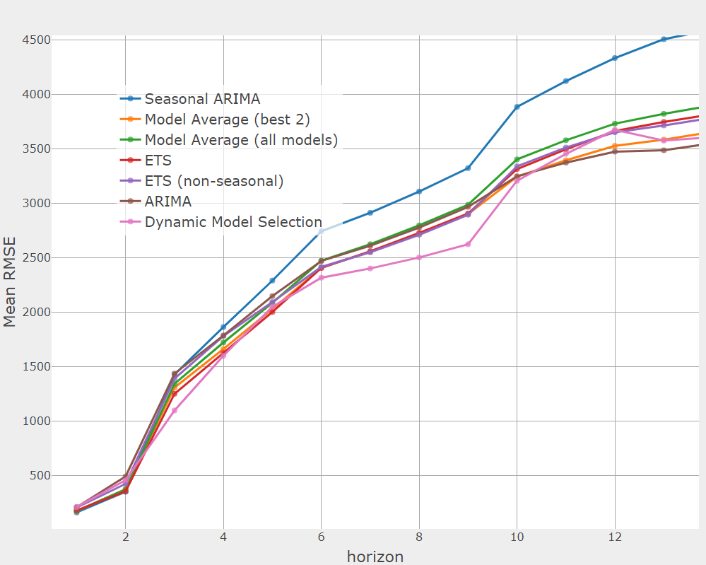
Out-of-Sample Output

Slide 21
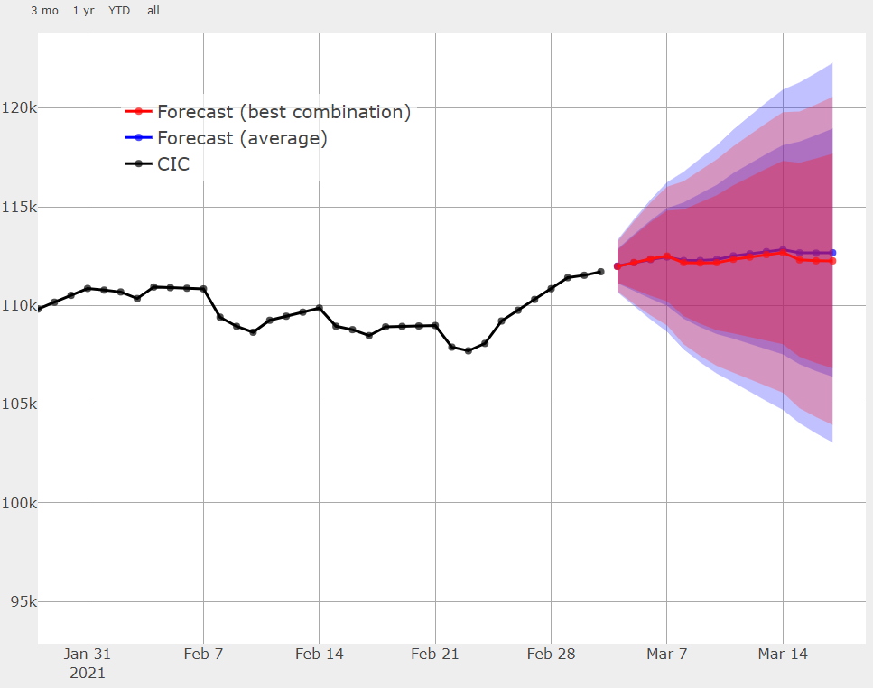
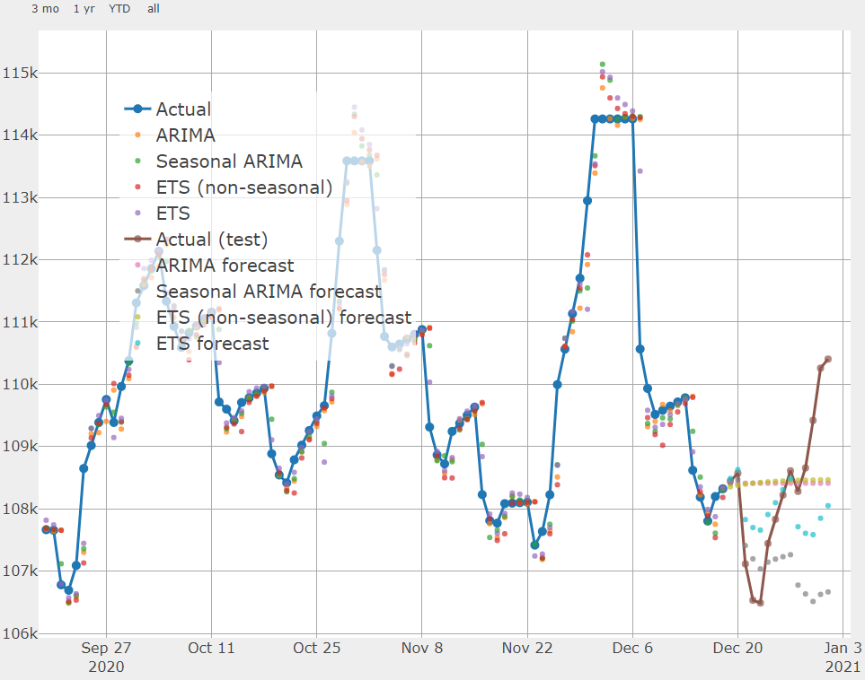
Forecasting Output

Slide 22
Software Infrastructure
R Codes
Input/Output
Data inputs
Config File
Framework
Validation File
Validation Reports
Forecast File
Forecasts Reports

Slide 23
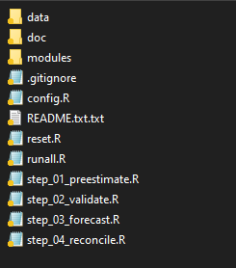
Forecasting Infrastructure in Practice

Slide 24
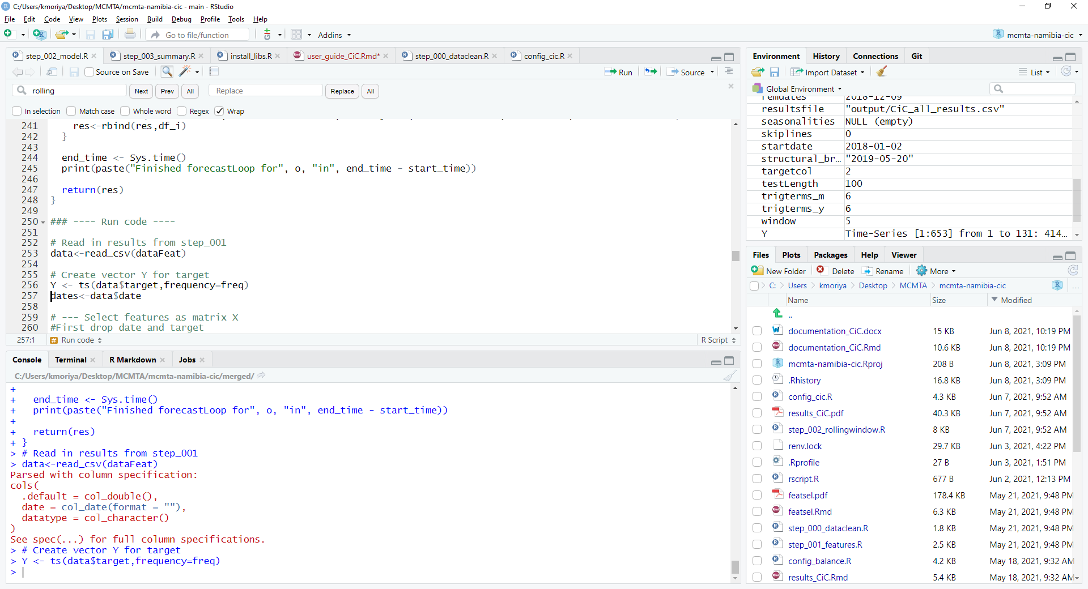
R Studio Interface (https://www.rstudio.com/ )

Slide 25



Operational Procedure
Data Feed
01
Every day update the data
Use an Excel template
Forecast
Every day, forecast the autonomous factors & total liquidity projections
Execute in a few seconds
Warnings for outdated validation
Validation
02
03
Once every quarter, or after structural break
Investigate models performance
Can take a few hours
Update config file

Slide 26
TA Questionnaire and Data Requests
Qualitative Questionnaire
Central bank framework, institutional arrangements, etc.
Data Requests
Daily data over the longest time frame possible
The data should be ready before the TA mission starts
The framework works for general time series forecasting, not only CB liquidity

Slide 27
Contributions
Forecast the three main autonomous factors with advanced models
Combine the autonomous factors forecasts into a single liquidity measure
Incorporate risk into liquidity forecasts
Use a robust modeling framework to deal with structural breaks and complex data samples
Automatic data reporting and data visualization
User-friendly interface based on an open-source and free statistical software (R)
Community of experts, working on public codes (Github)

Slide 28
Main References
Cabrero, Alberto, Gonzalo Camba-Mendez, Astrid Hirsh, and Fernando Nieto. 2002. “Modeling the Daily Banknotes in Circulation in the Context of Liquidity Management of the European Central Bank,” European Central Bank Working Paper No. 142, May.
Gray, Simon T. 2008. “Liquidity Forecasting,”, Bank of England, Centre for Central Banking Studies Handbook—No. 27, June.
Andrea Shaechter, 2000 “Liquidity Forecasting”, International Monetary Fund
Veyrune, Romain, Shaoyu Guo. 2019. “Autonomous Factor Forecast Quality: The Case of the Eurosystem”, IMF Working paper No. 19/296, December.
Anderson, D., & Burnham, K. (2004). Model selection and multi-model inference. 2nd ed. NY: Springer-Verlag.
Athanasopoulos, G., Hyndman, R. J., Kourentzes, N., & Petropoulos, F. (2017). Forecasting with temporal hierarchies. European Journal of Operational Research, 262(1), 60-74.
De Livera, A. M., Hyndman, R. J., & Snyder, R. D. (2011). Forecasting time series with complex seasonal patterns using exponential smoothing. Journal of the American statistical association, 106(496), 1513-1527.
Wickramasuriya, S. L., Athanasopoulos, G., & Hyndman, R. J. (2019). Optimal forecast reconciliation for hierarchical and grouped time series through trace minimization. Journal of the American Statistical Association, 114(526), 804-819.

Slide 29
Live Demo

